Slide 1

Exploratory Data Analysis on Aviation Dataset
BY SAHIL

Slide 2
INTRODUCTION:
Air travel, while statistically one of the safest modes of transportation, is still subject to accidents and incidents that can result in significant human and material losses. Understanding the contributing factors behind these events is crucial for improving aviation safety, guiding regulatory decisions, and enhancing pilot training and aircraft design.
This report explores and analyzes aviation accident data collected from the National Transportation Safety Board (NTSB), which includes detailed records of both accidents and incidents involving various types of aircraft across different countries and time periods. The dataset includes attributes such as aircraft make and model, weather conditions, engine type, number of injuries, flight phase, and airport location.

Slide 3
OBJECTIVE:
To identify trends and patterns in aviation accidents over time.
To assess how weather conditions, flight phases, and aircraft configurations influence the severity of accidents.
To examine which aircraft models, airports, and engine types are most frequently involved in accidents.
To provide data-driven insights that can inform safety improvements and policy-making in the aviation industry.
By combining statistical analysis with visual exploration, this report aims to uncover actionable insights from the data to support continued improvements in aviation safety.

Slide 4
DATASET OVERVIEW
Event Id: Unique identifier for each event (accident/incident).
Investigation Type: Type of investigation (eg :accident/Incident).
Accident Number: Case number for the accident, sometimes reused in related events.
Event Date: The date the event occurred.
Location: City or local area where the event happened.
Country: Country where the event took place.
Latitude: Geographical latitude of the event location.
Longitude: Geographical longitude of the event location.
Airport Code: Official airport code (if the event happened at/near an airport)
Airport Name: Name of the airport involved, if applicable Injury.
Severity: Severity of injuries (e.g., Fatal, Serious, Minor, or None)
Aircraft damage: Extent of damage to the aircraft (e.g., Substantial, Destroyed, Minor)
Aircraft Category: Classification of aircraft (e.g., Airplane, Helicopter)
.

Slide 5
DATASET OVERVIEW:
Aircraft damage: Extent of damage to the aircraft (e.g., Substantial, Destroyed, Minor).
Aircraft Category: Classification of aircraft (e.g., Airplane, Helicopter).
Registration Number: Aircraft registration (tail number).
Make: Manufacturer of the aircraft.
Model: Model name/number of the aircraft.
Amateur Built: Indicates if the aircraft was amateur/homebuilt (Yes/No)
.Number of Engines: Count of engines in the aircraft Engine.
Type: Type of engine (e.g., Reciprocating, Turbojet).
FAR Description: Code category under the Federal Aviation Regulations applicable to the
Flight schedule: Indicates whether the flight was scheduled or not.
Purpose of flight: Purpose of the flight (e.g., Personal, Business, Instructional).
Air carrier: Name of the airline or air carrier involved, if applicable.
Total Fatal Injuries: Number of people who died in the event.

Slide 6
DATASET OVERVIEW:
Total Serious Injuries: Number of people seriously injured.
Total Minor Injuries: Number of people with minor injuries.
Total Uninjured: Number of people not injured
Weather Condition: Weather at the time of the event (e.g., Visual, Instrument)
Broad phase of flight: Phase of flight during which the event occurred (e.g., Takeoff, Landing)
Report Status: Status of the official report (e.g., Preliminary, Final).
Publication Date: Date when the report was officially published

Slide 7
EDA(Exploratory Data Analysis):
STEPS:
1. Importing Necessary Libraries:
2. Loading and Reading File:
3. Columns Overview:
4. Statistical Summary:
5.Data Cleaning:
1.Handling null values:
1.1. Dropping Unnecessary columns:
1.2.Replacing null values in categorical columns by ‘unknown’.
1.3 .Replacing null values in the numerical column by median.

Slide 8
EDA(Exploratory Data Analysis):
6 . Checking Datatypes:
7. DataTypes Conversion:
7.1. Converting Event Date to datetime:
7.2. Converting numerical columns to integer from float:
8 . Droping Duplicates:
9.Data preprocessing:
1.creating boxplot for numerical columns:
2. creating new features:
2.1. Year.
2.2 Month.
2.3 Day.

Slide 9
INSIGHTS FROM DATA PREPROCESSING:
1. Number of engines:
# Maximum number of Aircrafts have 1 engines ( Aircraft = 69582)
# Some aircraft even don't have engines (Aircraft = 1226)
# There are 3 Aircrafts which have the maximum number of 8 engines:
2. Total Fatal Injuries:
# Highest number of people(349) died in an accident on 1996-11-12 in India New Delhi:
3.Total Serious Injuries:
# The highest number of total serious injuries(161) took place on 2020-02-05 in Istanbul Turkey:
4.Total Minor Injuries:
# Highest number of total minor injuries took place in an incident on '2000-07-23; in MONTREAL, Canada.

Slide 10
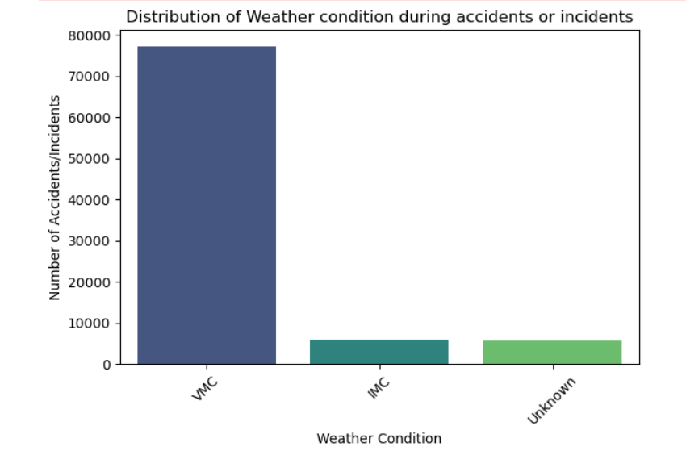
1. Weather condition during accidents or incidents:
1.VMC = VISUAL METEROLOGICAL
CONDITION (WEATHER IS CLEAR).
2.IMC = (POOR VISIBILITY WATHER)
HIGHER RISK.
# Insight:
Highest number of accidents/incidents (77302) took place when weather condition was (VMC) clear weather.

Slide 11
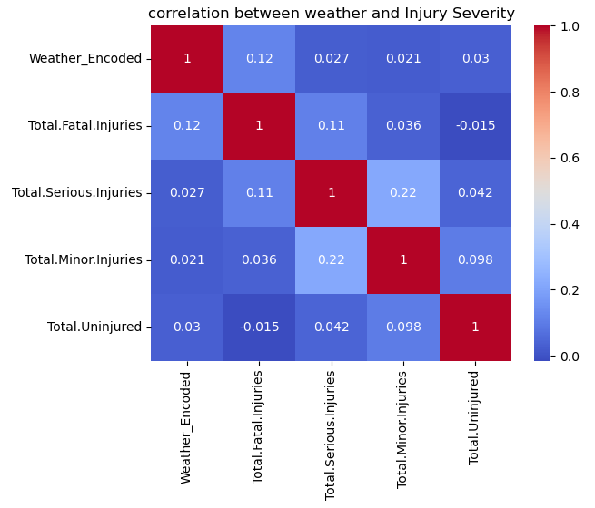
2.Correlation Between Weather and Injury Severity
1.There is no strong or meaningful relationship Between the weather and injury severity.
2. Most correlations coefficients are close to zero.
Suggesting weak or negligible correlation
# Conclusion:
Weather may alone may not be the significant
Indicator of injury severity.
Other factors outside of weather plays a crucial role in injury outcomes.

Slide 12
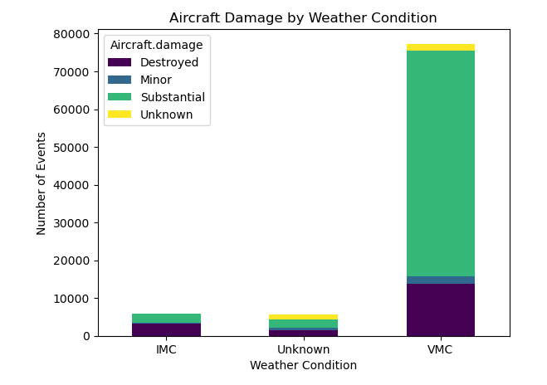
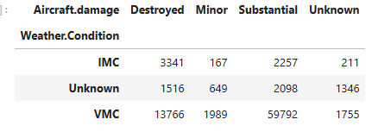
Aircraft Damage By Weather Condition.
Insight:
VMC(Visual Meteorological Condition)
Shows the higher number of substantial
damage followed by the Destroyed and
substantial.

Slide 13
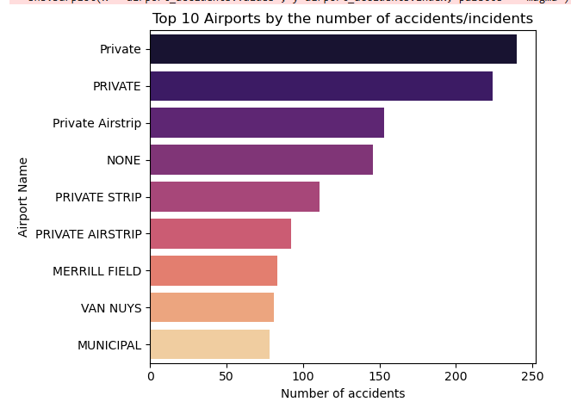
3.Top Ten Airport by Accidents/Incidents:
# Insight:
The airport with the highest number of accidents/incidents is labeled "Private," approaching around 230 accidents/incidents.

Slide 14
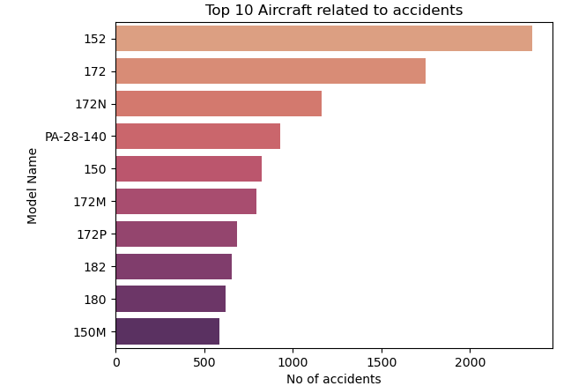
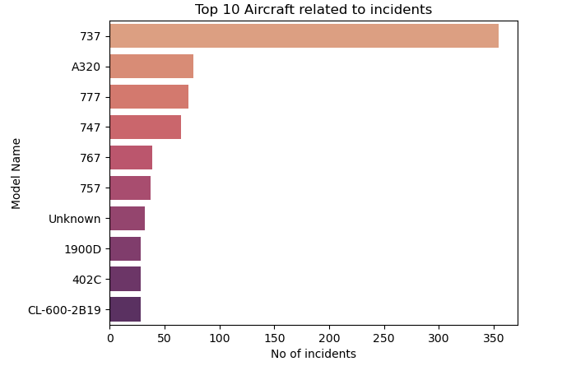
4. Aircraft model by Accidents and Incidents:
# By accidents:
Aircraft Model 152 is related with the highest number of accidents.
# By incidents:
Aircraft Model 737 is related with the highest number of Incidents.

Slide 15
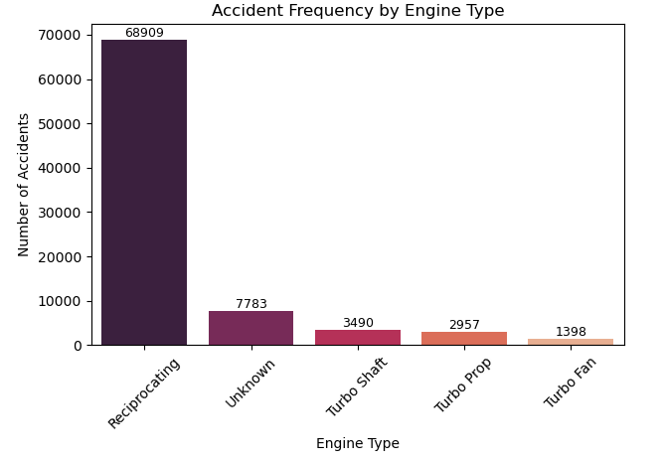
5.Accidents Frequency By Engine Type:
Insight:
Aircraft with the Reciprocating Engine type
Is related with the highest number of Accidents.

Slide 16
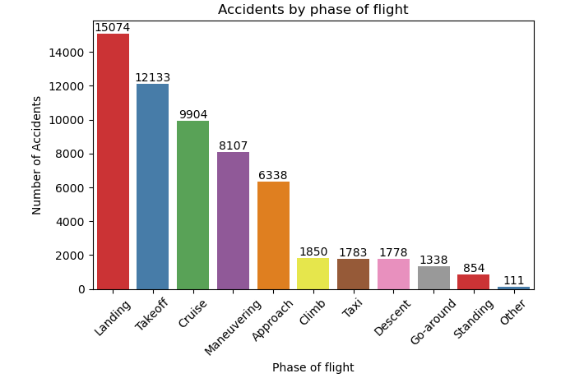
6. Accidents by Flight Phase
# Insight:
Highest Number of Accidents occurred during Landing and Takeoff of flight

Slide 17
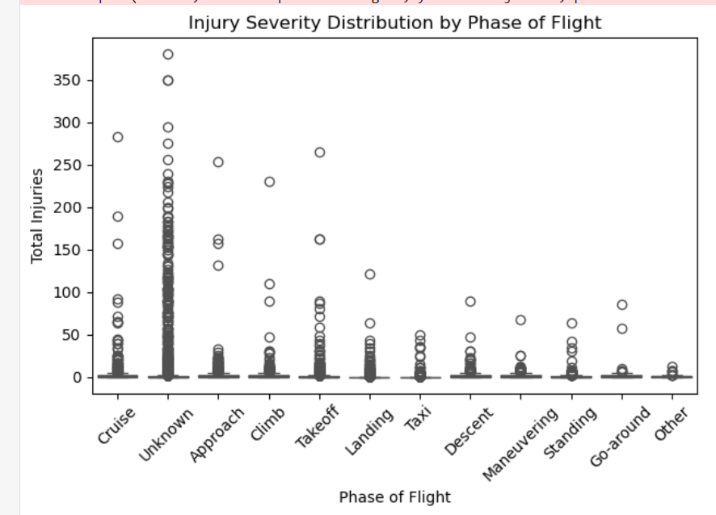
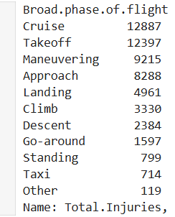
7. Injury Severity By Phase of Flight:
# Insight:
The plot reveals that while most injuries tend to be less severe, there are occasional high-severity events across various phases, especially in "Cruise“ , “Takeoff”
and approach

Slide 18
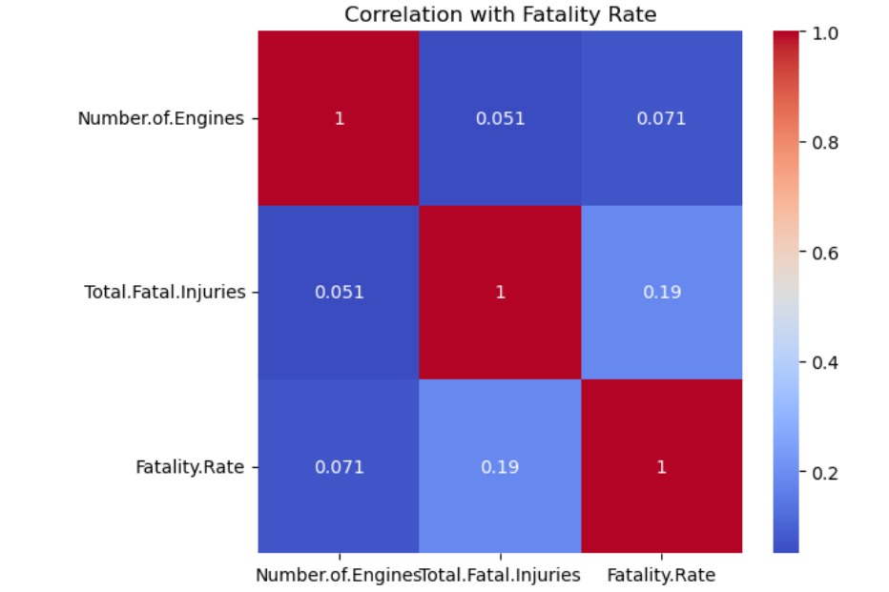
8 . Factors Associated with Fatality Rates:
1. Fatality Rates vs number of engines:
# Insight :
There is a very weak positive correlation(0.071) between the number of engines and fatality rates:# It means fatality rate is very less associated with the number of engines in a aircraft.

Slide 19
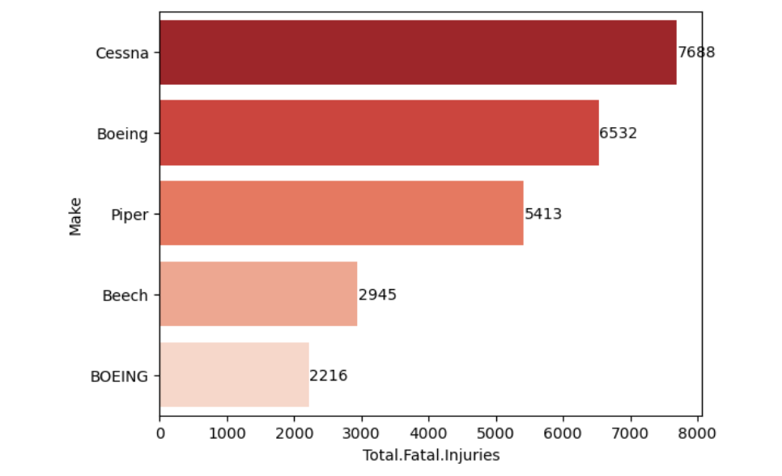
8.2 Total Fatal Injuries vs Aircraft make:
Insight:
Aircraft Make Cessna has the highest no of total fatal injuries (7688).

Slide 20
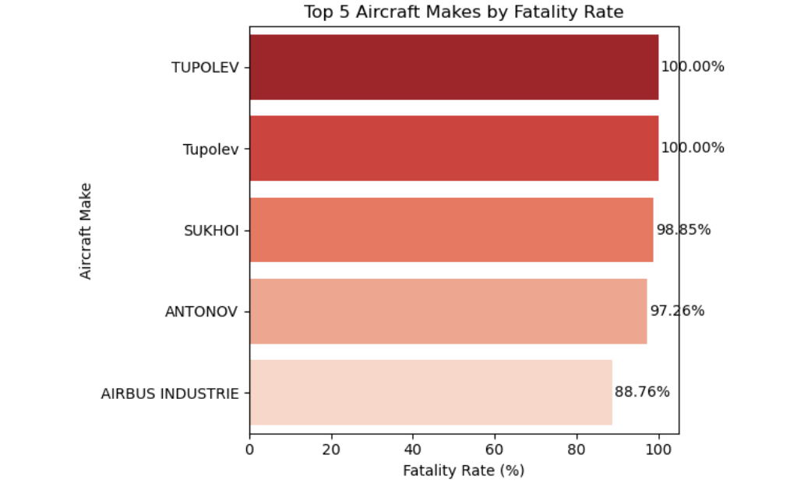
8.3 Fatality rate vs aircraft make:
Insight:
Aircraft Make Tupolev has the highest fatality rates(100%) (most deadly aircraft not suitable for travel purpose).

Slide 21
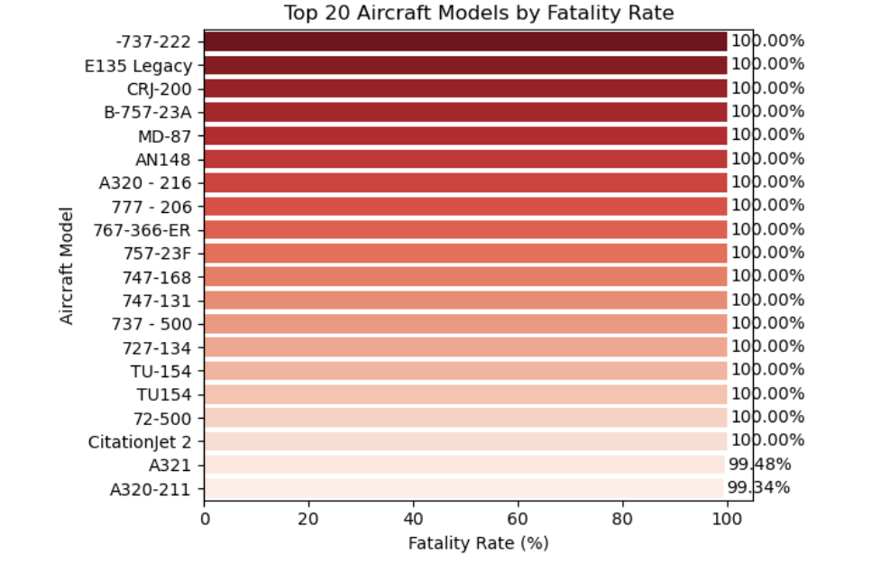
8.4 Fatality rates vs models:
# Insight:
There are 18 aircraft models with the 100% fatality rates which are not suitable for travel

Slide 22
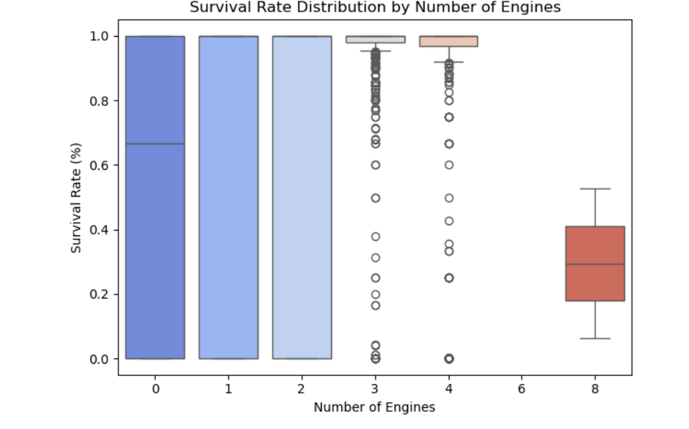
9. Survival Rate vs Number of Engines:
# Insight:
1. The survival rate tends to be high and consistent for 0, 1, and 2 engines, with medians near 100%.
2.For 3 and 4 engines, survival rates are more spread out, with some outliers and slightly lower median values.
3.For 8 engines, the survival rate distribution shifts lower, with a median around 20%, indicating lower survival rates for ships with more engines.
Overall, increasing the number of engines appears associated with decreasing survival rates.

Slide 23
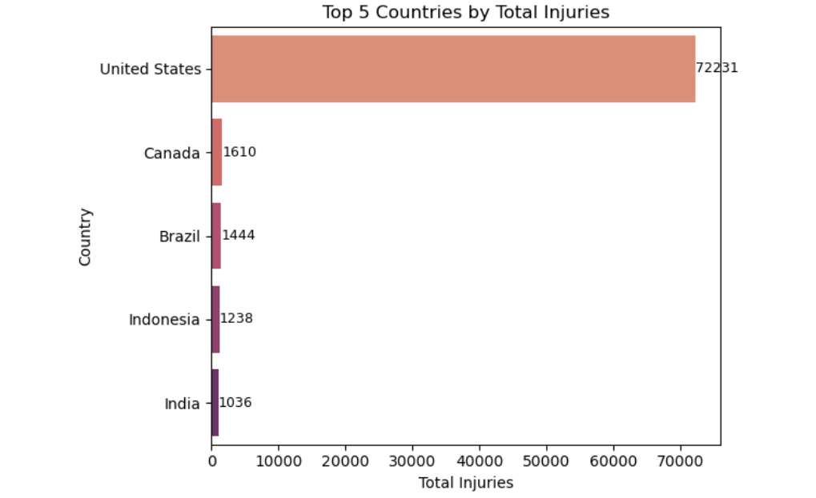
10 Injury By Countries:
# Insight:
# The country Which is associated with highest number of injuries is United States(72231)

Slide 24
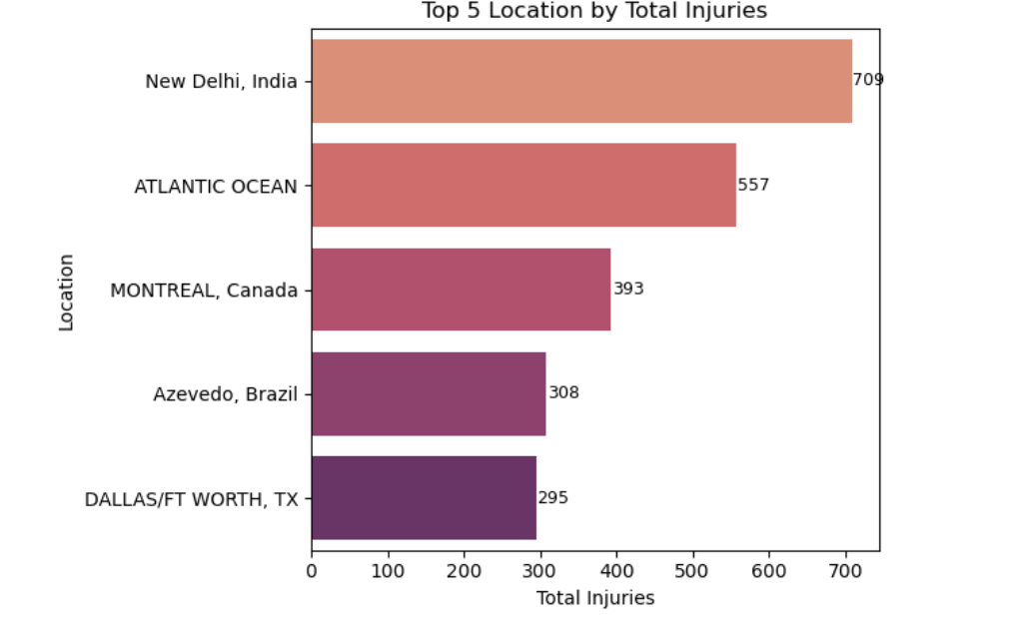
11. Injury By Location:
Insight:
New Delhi , India is associated with the highest number of Injuries(709) by Location

Slide 25
✈️ Aviation Safety Recommendations
Don’t Rely Solely on Clear Weather (VMC)
Most accidents happen in clear weather; enhance pilot focus and procedural discipline even in good conditions.
Improve Private Airport Safety
Strengthen infrastructure, compliance, and safety checks at private airstrips.
Target High-Risk Aircraft Models
Monitor models like 152 and 737 closely; improve maintenance and pilot training.
Focus on Reciprocating Engine Aircraft
Increase engine checks and failure response training.

Slide 26
✈️ Aviation Safety Recommendations
Boost Safety During Landing, Takeoff, and Cruise
Provide extra simulator training and real-time system support during critical phases.
Review High-Fatality Aircraft Models
Investigate or phase out aircraft with consistent 100% fatality rates.
Engine Count vs. Survival
Extra engines don’t guarantee safety; improve emergency planning for large aircraft.
Regional Action Plans
Focus on the U.S. and New Delhi for injury hotspots with tailored safety initiatives.
Use Predictive Analytics for Risk Assessment: Train machine learning models on past accident data to forecast future risks and proactively prevent incidents.

